Slide 1
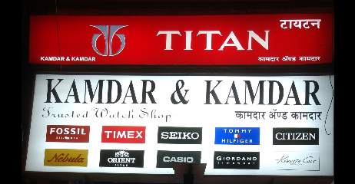
We M/s Kamdar & Kamdar Established In The Year 1971. Are Now The Pioneer In Retail and The Most Trusted Name In The Horological Trade In India. The Firm Was Founded In The Year 1971 By Founder Shri Prafulbhai V. Kamdar.
On 14th November 1971, Shri Prafulbhai V. Kamdar Started His Journey With A Small Shop. In Dadar. Thereafter He With His Hardwork ,Dedication And Leader Ship Qualities Added His Brothers Into The Business And Started His Journey Of Growth. Now Presently Shri Prafulbhai V. Kamdar With Mr. Deepak P. Kamdar And Mr. Prakash P. Kamdar His Sons Are Taking Care Of Reatailing, Servicing & Trading Of. All International & National Watches & Highly Involed In Corporate Gifting & Customized Services For Our Many Estemed Corporate Customers. The Firm Was Also Been Awarad By The Biggest Watch Brand In Our Country, TITAN With The Award Of LARGEST TITAN RETAILER IN INDIA.
The Firm Is Presently Authorised Sales & Service Agents For All Major National & International.
Watch Brands ,Wall Clocks, Calculators & Writing Instruments.
Introduction :

Slide 2
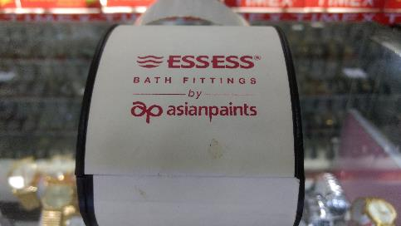
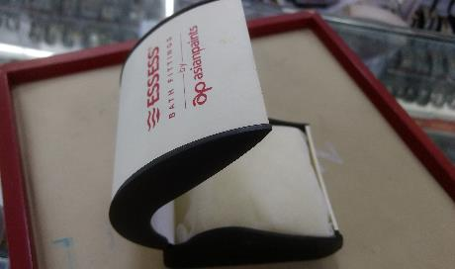
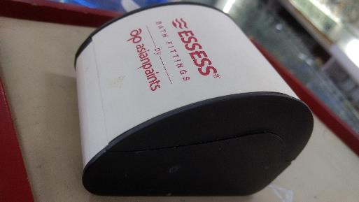
Sample for customize box.

Slide 3
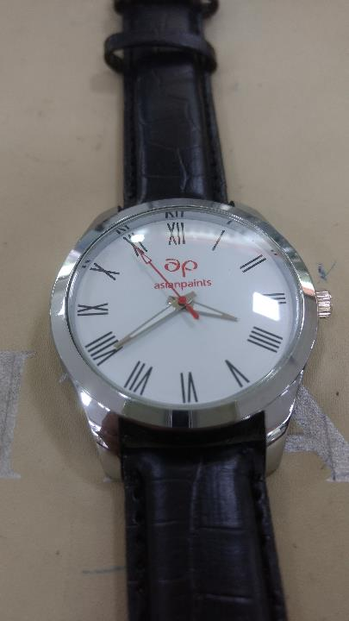
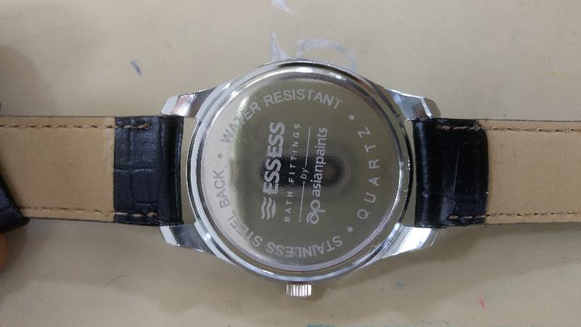
Sample for customize watches.

Slide 4
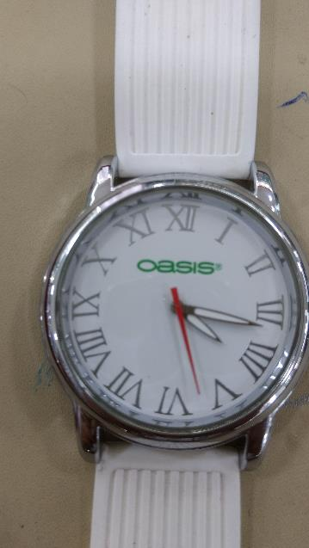
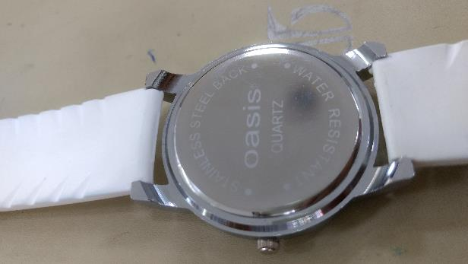
Sample for customize watches.

Slide 5
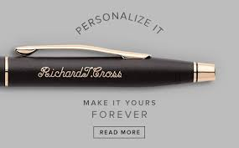
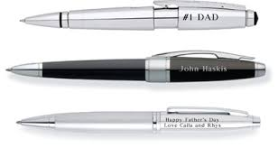
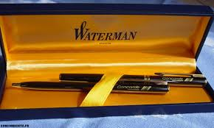
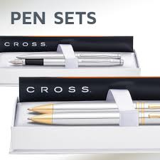
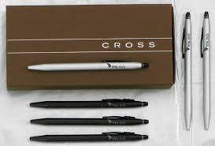
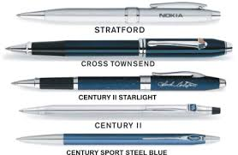
Personalized pens.

Slide 6
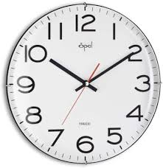
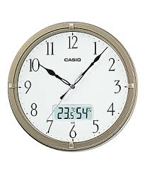
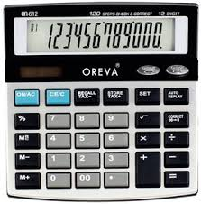
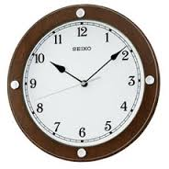
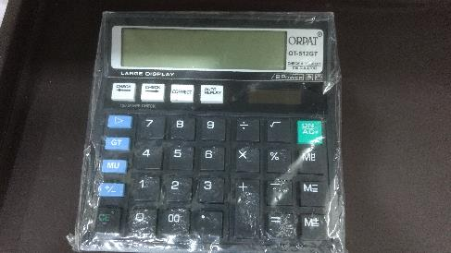

Wall clocks and calculators.

Slide 7





Titan Skinn.
50ml and 100ml bottels are available.

Slide 8
Contact info:
Deepak Kamdar ; 9892048801 / 9987577777 / 2413 1243.
Kamdar & Kamdar, 6/174, Vincent view, Dr. B.A. Road, Dadar (EAST), Mumbai - 400 014, Mumbai, India.
deepakkamdargroup@gmail.com

Slide 9

Thank you.

